Slide 1

Group Name: Twogether
Hackathon 2023
If you're in need of any services, we're here to customize our offerings to perfectly align with your unique requirements.
Notes:
Introduction:
Arrlone pal Min ga lar par ! Thank you for the food!
Good Morning judges !
We are group Twogether :
Are you excited ! We are very excited! What do you think our idea gonna be?
Our Mini App name is Lo Ta Ya in Burmese means “genie in the bottle”(digital service platform that matches your need for all)
You can name any services that you need in your daily life, we gonna be the digital platform to provide your needs.

Slide 2
Meet our Team
Ei
#HR/Leader
KK
#Developer
Ei Zin
#Developer
Aye
#Strategy
Hsu
#Digital
San
#Business
Notes:
You have already met our team members.
Ei : in charge of alignment and making sure that all things goes well.
Kaung Gyi & Ei Zin ( our core team members : making sure that what you gonna see in the our mini apps are working well) demo
Hus: Preparing and providing all the backend data
San: getting the data & preparing the presentation (she is also the second in charge in our team making sure that we are working on one-idea)
Here I am “Aye Mon” : I am bits and pieces of everywhere.

Slide 3




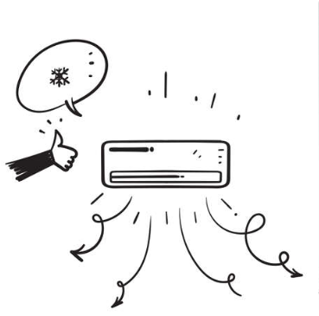




Agenda
5 mins
15 mins
10
mins
Part 1
Story set
Overview
Service Offerings & Features
Part 2
User Journey
Tech-Demo
Part 3
Roadmap & Future
Q & A
Notes:
We gonna walk you through in 3 parts.
Part 1: overview of the apps and our offerings
Part 2: Demo session
Part 3: Roadmap & the future + Q&A

Slide 4

Part 1

Slide 5






Story Set
End-User Pain Points
My helper went missing, I need someone to attend to my grandpa urgently.
Traffic
Time
Safety
Cash payments
Low quality services/Fraud
Difficulty finding right people at right time
I am too tired to do house chores today and my newborn is so clingy on me. I need someone to help.
Service-Providers Pain Points
Customer acquisition
Sustainable income
Advertising and branding
Notes:
We want to solve the pain points in your daily life. We are going to solve people daily life problems. Your time, your safety, meeting low quality services, fraud, can't find good people to assist your needs.
Not only that also to help the service provider and freelancer current challenges: job opportunity, sustainable income, branding.

Slide 6

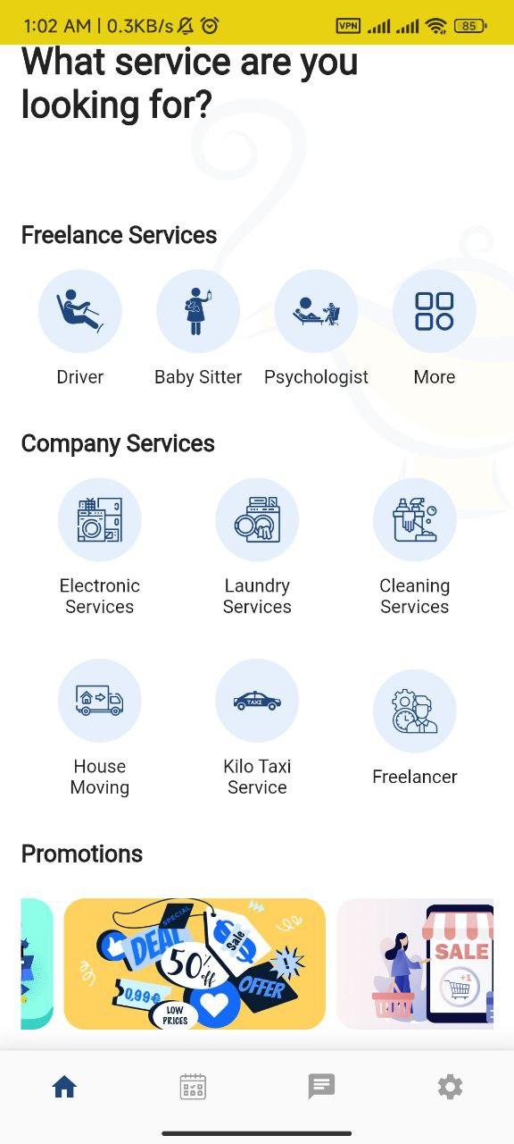
Overview
Service offerings that perfectly align with your unique requirements.
One stop services for all
High Level Concept:
A digital platform that connects customer daily needs with service providers and freelancers.
Target Customers:
Housewives, Working Professionals, Seniors, Businesses
Benefits:
Effective end to end process
Variety of service offerings
Access to promotions and coupons,
Reliable service providers/freelancers
Yangon
Mandalay
Nay Pyi Taw
Taunggyi
Build a better Myanmar for its people
Notes:
We came out with the idea that align with our mission “ building a better Myanmar for its people”
A digital platform that connect service providers and freelance with customers. Matching customer demand and needs with service providers.Target operating area in 4 main cities across the country.
There are advantages and benefits. “ one platform for all kind of services” you can search through our apps , additionally current promotions to save your cost as well.

Slide 7
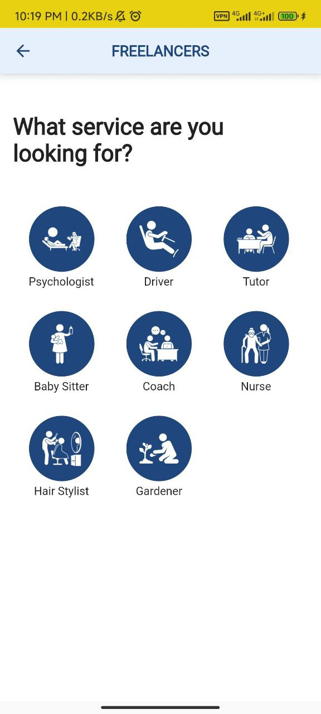






Key Services
Electronic Repair
House Moving
Laundry
Freelancer
Kilo Taxi
Home Cleaning
#onboarding trusted service providers & freelancers
Notes:
Home cleaning/ helper services, laundry, electronic repair “ such as air con”. Kilo taxi: instant booking /you can schedule your booking in advance.
Freelancer: Nurse aid, baby sister, visa services
Merchants can also rate users. Your can show your detail address in map , call center to resolve if there are any dispute
The call center & Lo Ta Ya customer engagement team will onboard the service providers with strict user onboarding process and making sure that they are reliable.
Wave user can also be register as freelancers for job opportunity.
Increase customer based.

Slide 8
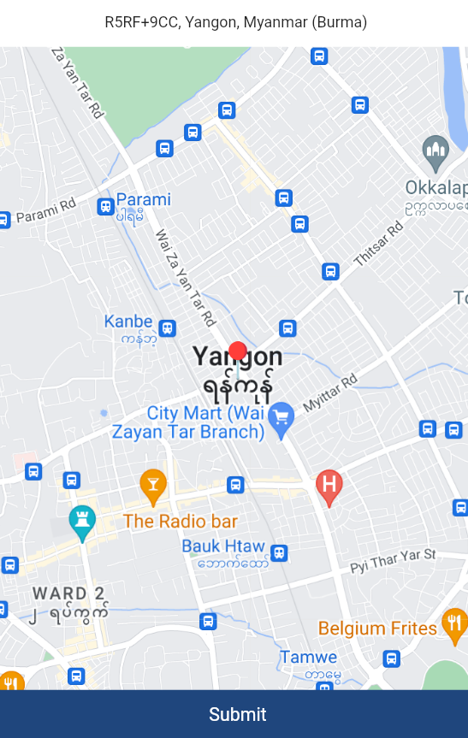


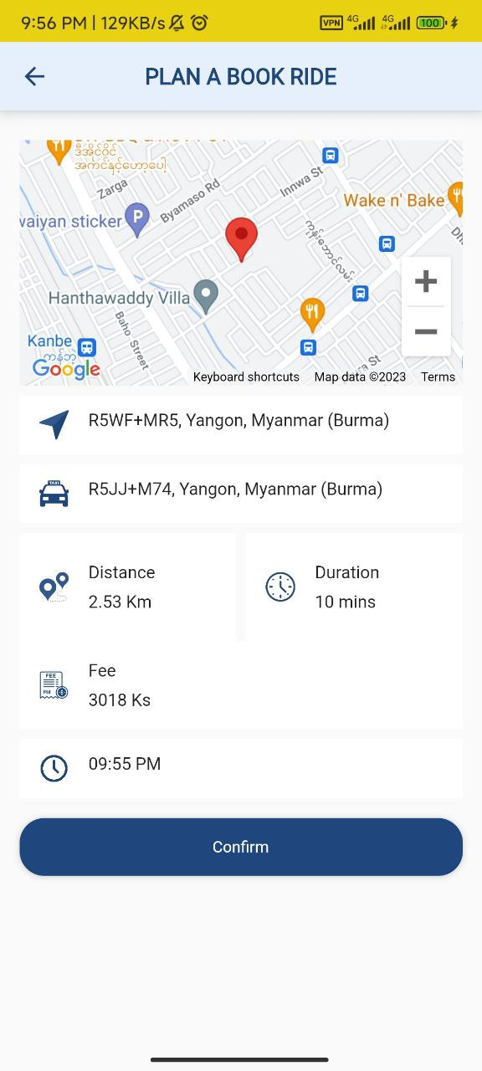
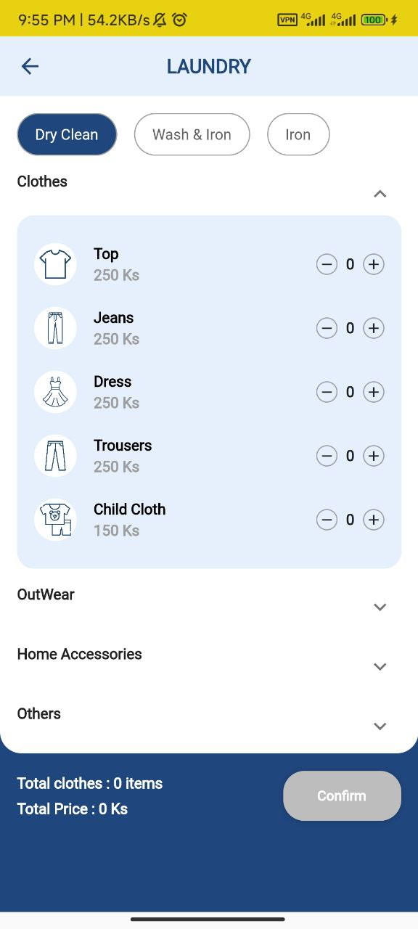
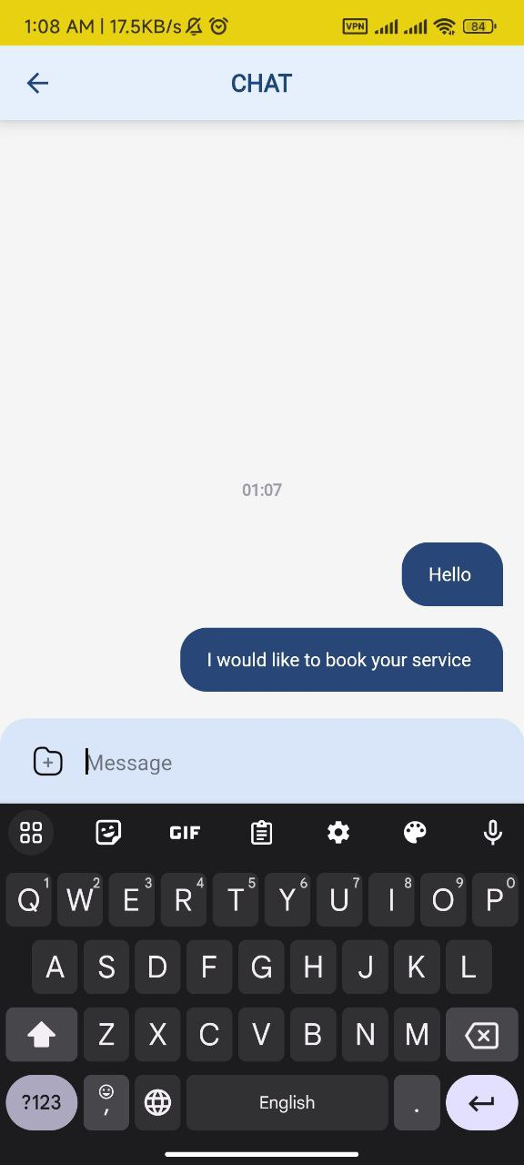







Features
Customer rating
Location
Realtime chat
Booking
Call center
Secured payment
Advertising & Promotion
Available time
Customized request
#3% service fees for every transactions
Notes:
Home cleaning/ helper services, laundry, electronic repair “ such as air con”. Kilo taxi: instant booking /you can schedule your booking in advance.
Freelancer: Nurse aid, baby sister, visa services
Merchants can also rate users. Your can show your detail address in map , call center to resolve if there are any dispute
The call center & Lo Ta Ya customer engagement team will onboard the service providers with strict user onboarding process and making sure that they are reliable.
Wave user can also be register as freelancers for job opportunity.
Increase customer based.

Slide 9





Part 2
Demo

Slide 10


Customer Journey
1
2
3
4
6
8
Log into wave money
Click to LoTaYa Mini App
Onboarding Page/Go to Services
Request Booking
Make Payment
Receive Service
Customer
6
10
Receive Payment & Hold Payment
Release Payment
4
5
7
8
9
10
Receive Booking Request
Accept/Reject Service booking
Connect with user
Provide Service
Complete the Service
Receive Payment
Yes
Service Providers

Slide 11


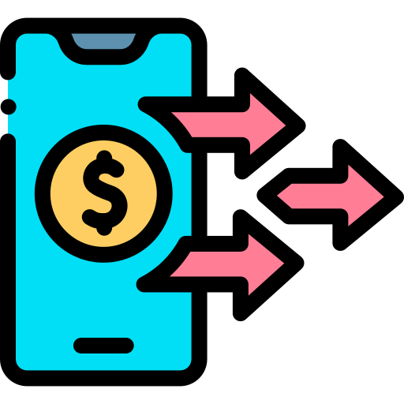

Part 3

Slide 12





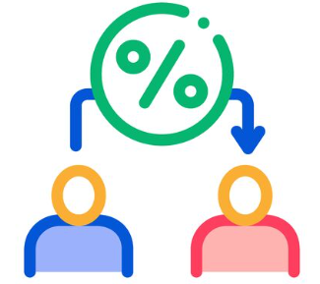

Lo Ta Ya Mini-App aims to drive additional revenue, brand presence, increase customer retention and customer base.
01
02
03
10% + additional Monthly Active Users
Usage increased: 10% + additional transactions
Trusted App
04
05
06
Customer
lifetime value
Profitability
Retention rate
Notes:
in responsive to address the needs of customer demands and market trend.

Slide 13

Roadmap & Future
Phrase 2
E-commerce Marketplace.
Operating in all cities across the country.
200,000+ monthly active users.
2025
2024
Target
See you all again in 2025!
WAVE SUPER APP
Now!
One stop service platform.
Operating in 4 main cities.
100,000+ monthly active users.
2023

Slide 14
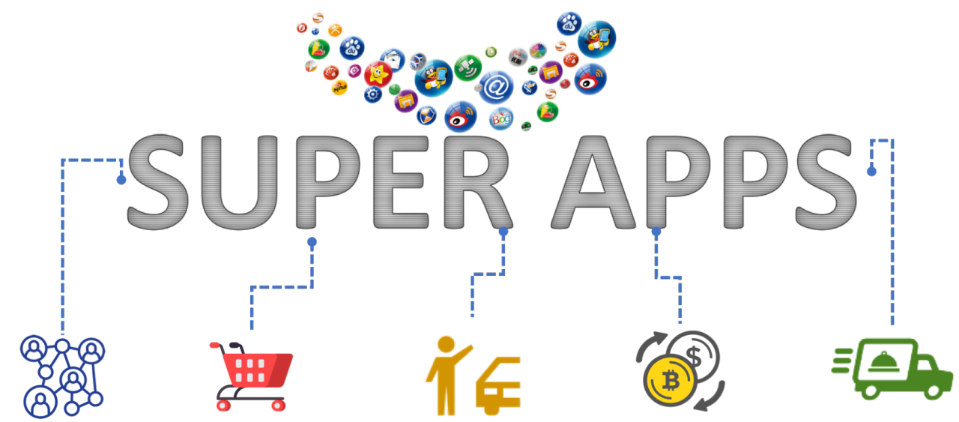
Thank you! Q&A
Social
E-commerce
Ride hailing
Payment
Delivery

